Slide 1
Data Analysis projects
By: Hamilton conceicao
Justit bootcamp

Slide 2
Excel & tableau data visualization
Project Title:
The wealth of Nations

Slide 3
Introduction
Currently, we are living in the era of big data, where data has been described as a raw material for business. The volume of data used in businesses, industries, research organizations, and technological development is massive, and it is rapidly growing every day.
The more data we collect and analyse, the better for business in making those critical decisions. However, with the enormous growth of data, it has become harder for businesses to extract crucial information from the available data.
That is where the importance of Data Visualization becomes clear. Data visualization summarises and presents a huge amount of data in a simple and easy-to-understand format to communicate the information clearly and effectively.

Slide 4
Scenario
This assignment was given to me, to work on the Wealth of Nations project.
Considering the fact the client is colour blind, I have created a visual report, that will show the data in the form of charts and maps using Tableau, to help the client understand and make better decision making.
Firstly, I will consider data protection and computer misuse policies. Then, I will go through step by step explaining the data set presented on the Excel sheet.
As a data analyst, it is important to understand the importance of data protection and the steps that must be taken to ensure that sensitive information is kept secure.

Slide 5
Policies and Procedures
Data Processing Policies - Organisations should map the way data flows, to see what data is being processed, how it’s being used and who is receiving it.
Encryption Policy - Policy that helps obscuring information and replacing identifiers with something else, meaning it is only accessible or understandable to approved users.
Passwords Policies Passwords should be always kept safe, should not be shared or displayed with anyone.
Email policies - Email policies should, therefore, mandate that employees take regular staff awareness courses, to stay up to date with the threat of email-based fraud. (Phishing)

Slide 6
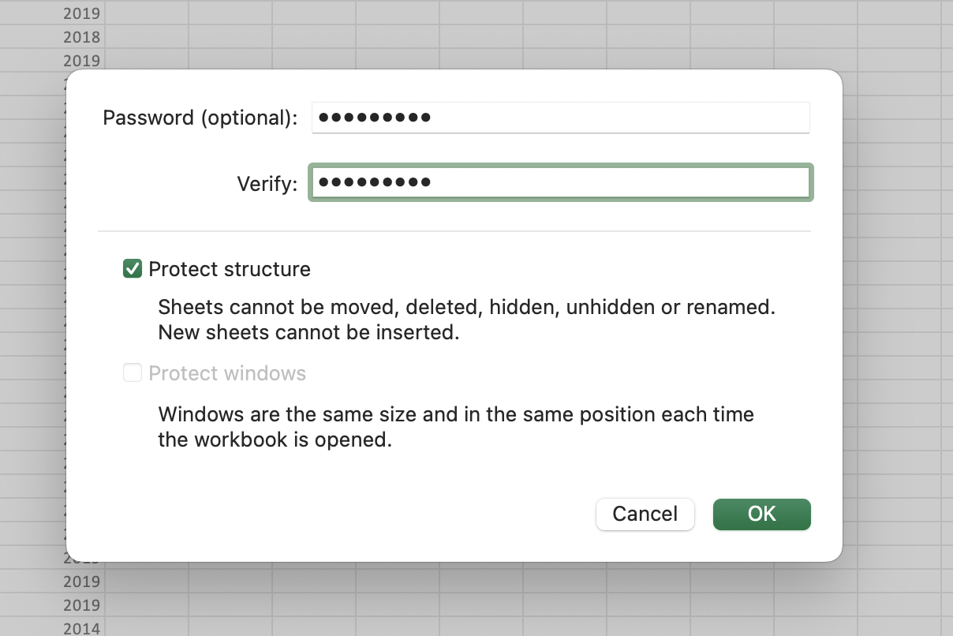
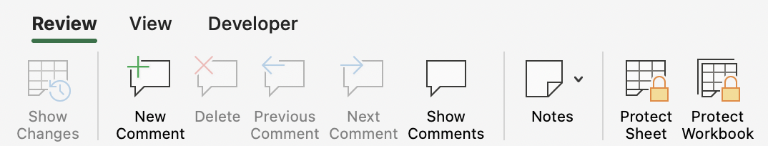
Create a Password to protect Workbook Before I start organizing and make changes to the Workbook, I will have to protect it, for security measures. To do this, once the Workbook is open in Excel, go to Review Tab, click on protect Workbook, a screen will appear for you to create and verify a password, then click ok. Your Workbook will automatically be protected

Slide 7
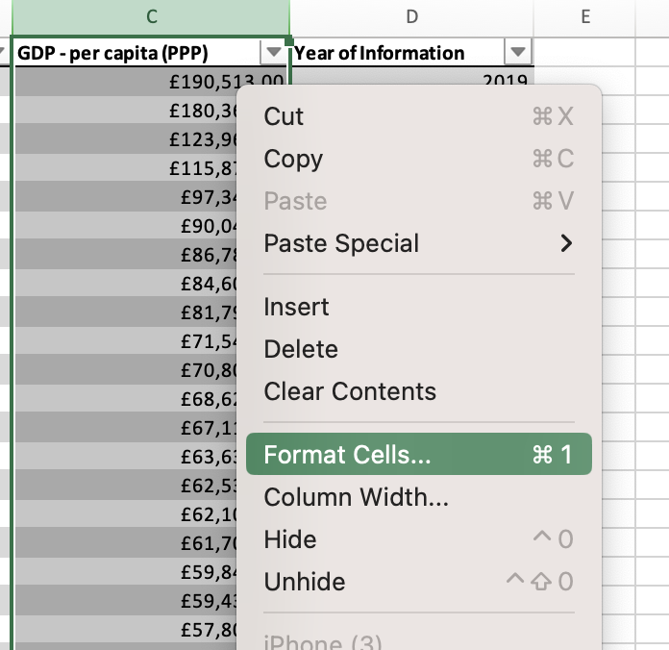
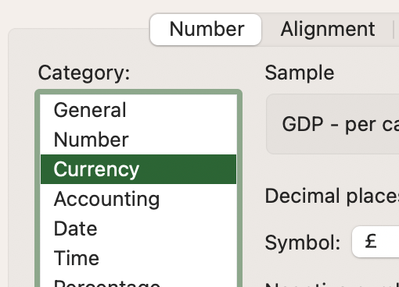
Change Column C to display British Pound symbol Click on the letter C at the top of the Column to select entirely, right click and select “Format Cells” from the context menu then in the Format Cells dialog box, go to “Number” tab, then select “Currency” clicking on the £ symbol, then OK, column C is now displayed in British Pound £

Slide 8
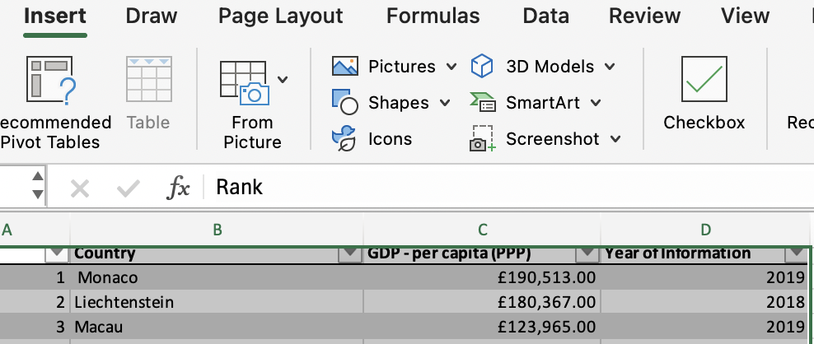
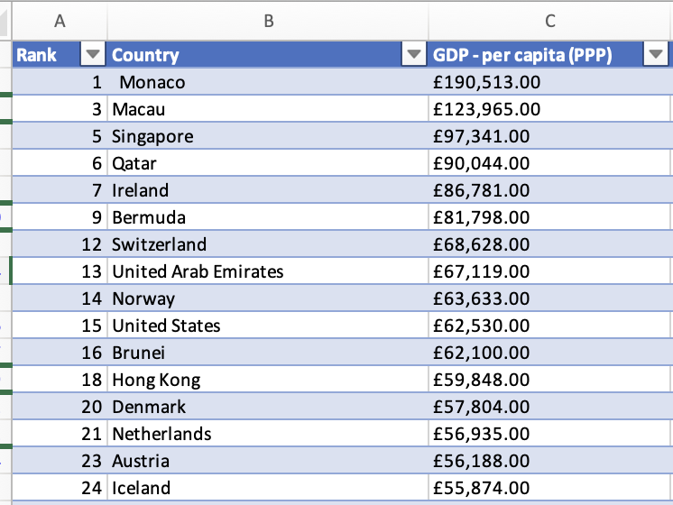
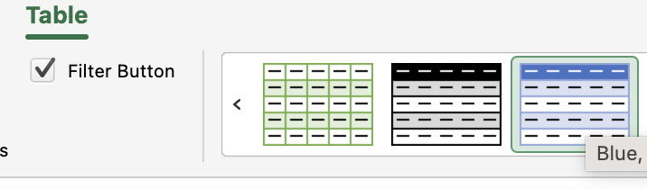
Turn the GDP Sheet into a table Select Data range, including headers, go to “Insert” on the ribbon, click on “Table”, then OK

Slide 9
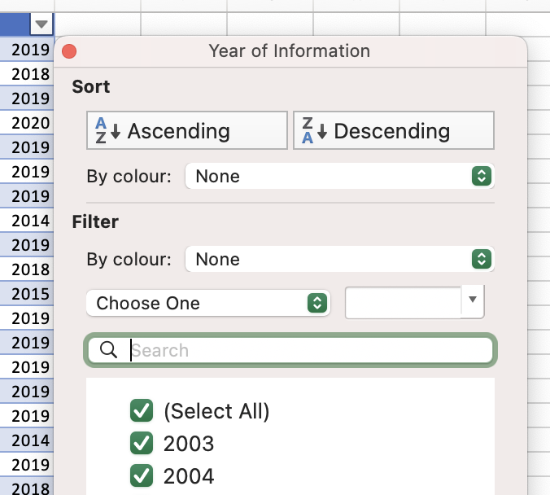
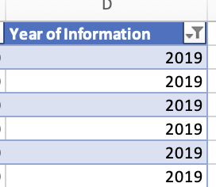
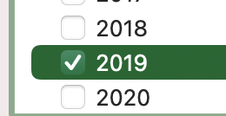
Filter to display only the information for 2019 Click the small dropdown arrow that appears next to the “Year of Information header” A table will appear, filter by year, by unchecking “Select All” to clear all sections, then check only the box next to 2019, click OK The table will now filter out to display only Year of Information 2019

Slide 10
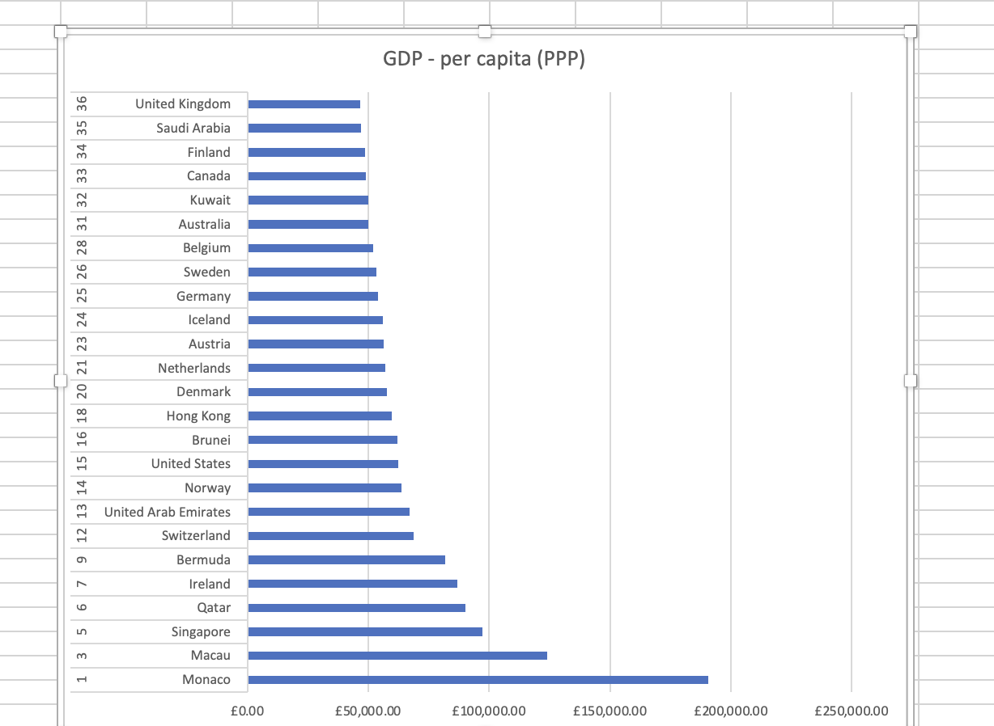
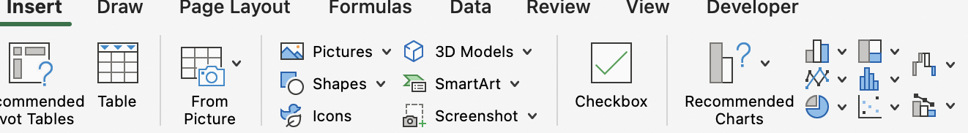
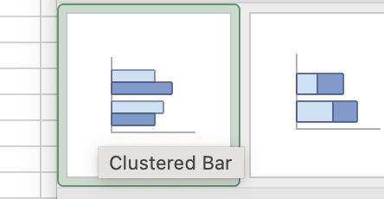
Create a chart displaying “Rank’, “Country”, “GDP”- per capita Select Columns A, B and C, go to “insert tab, charts group, click on the Bar chart icon. Choose Bar chart – Clustered Bar, form the dropdown menu

Slide 11
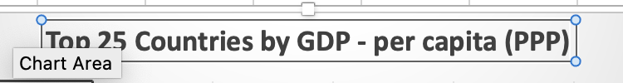
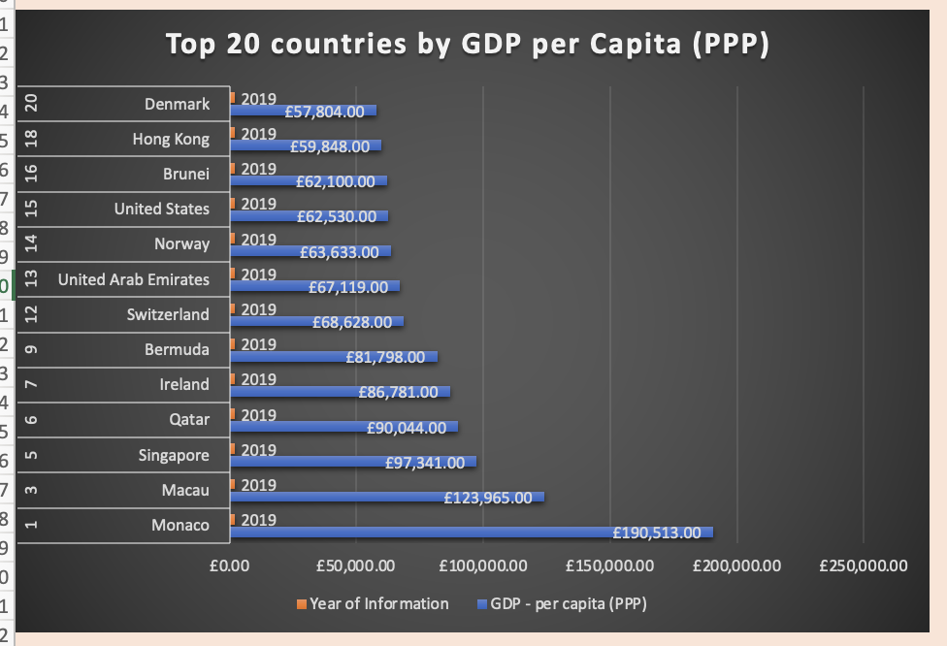
Creative Skills to edit the chart, add X and Y axis to make it visually pleasing The title goes at the top of the chart, to clearly convey what the data represents
Making the chart visibly pleasing, I will go to chart design and choose one that is appealing and easy to read

Slide 12
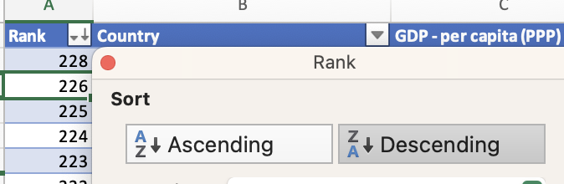
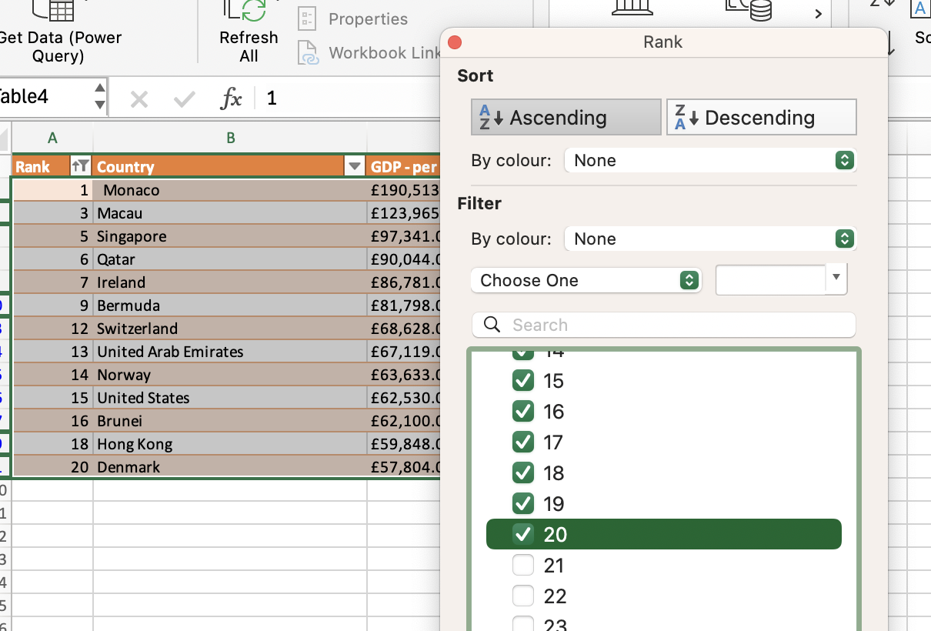
Create a sort for the Top 20 countries highest ranking countries Click on the filter icon next to the Rank header, from the dropdown box, select sort by “Ascending”

Slide 13
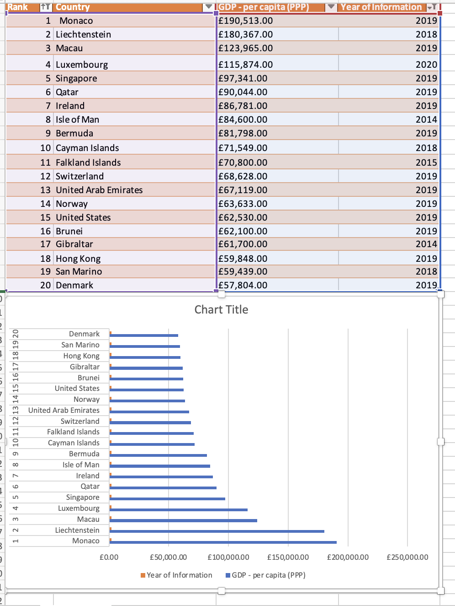
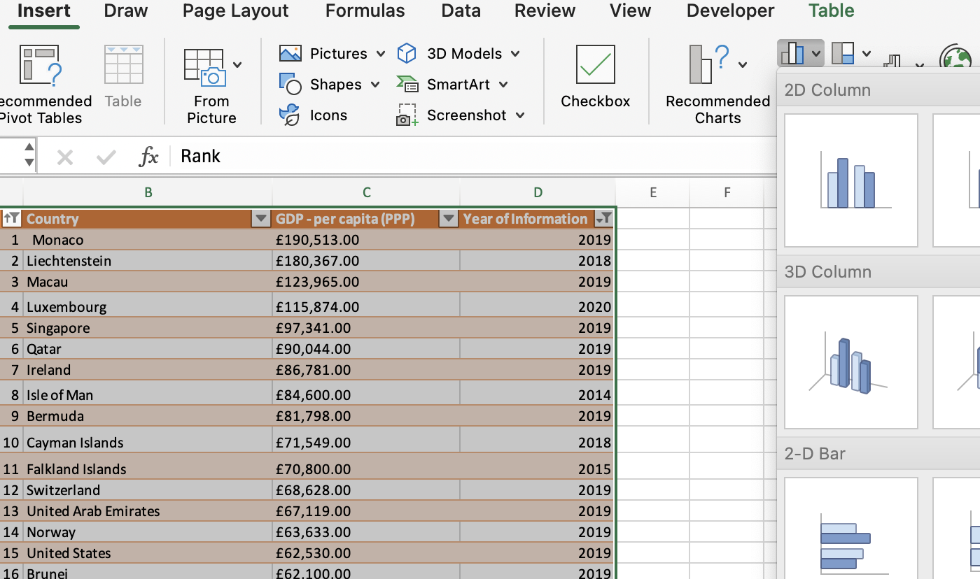
Create new bar chart to display top 20 countries, then move the chart to be underneath the table

Slide 14
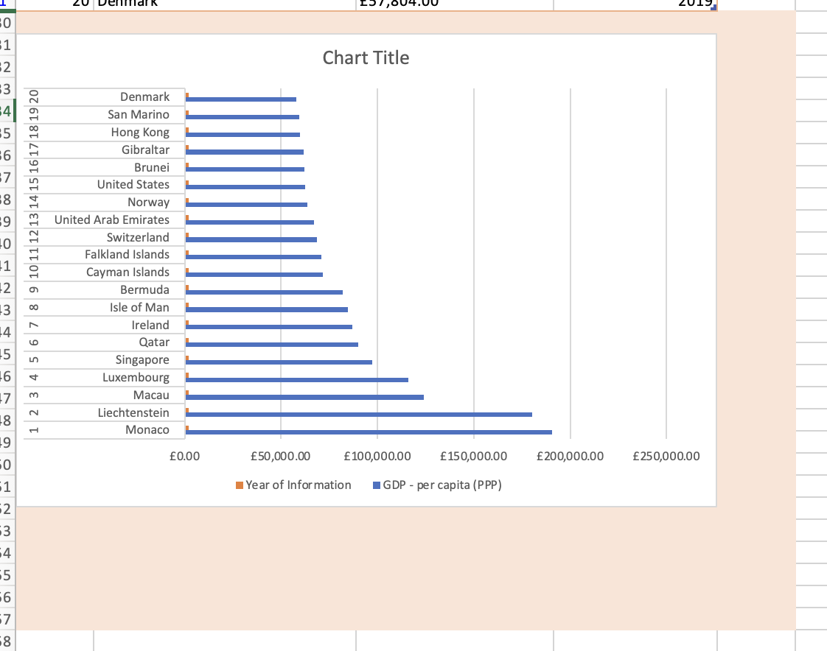
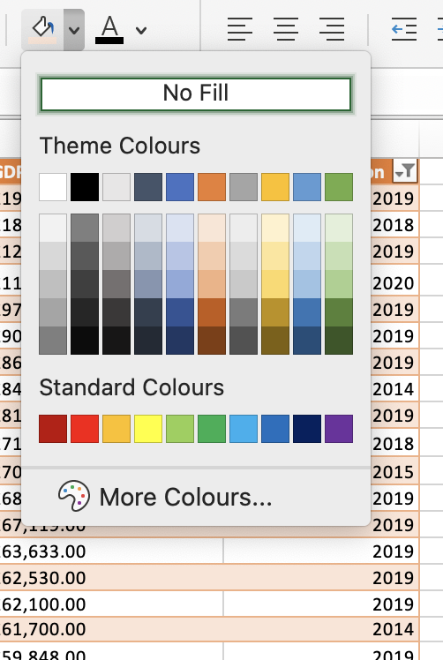
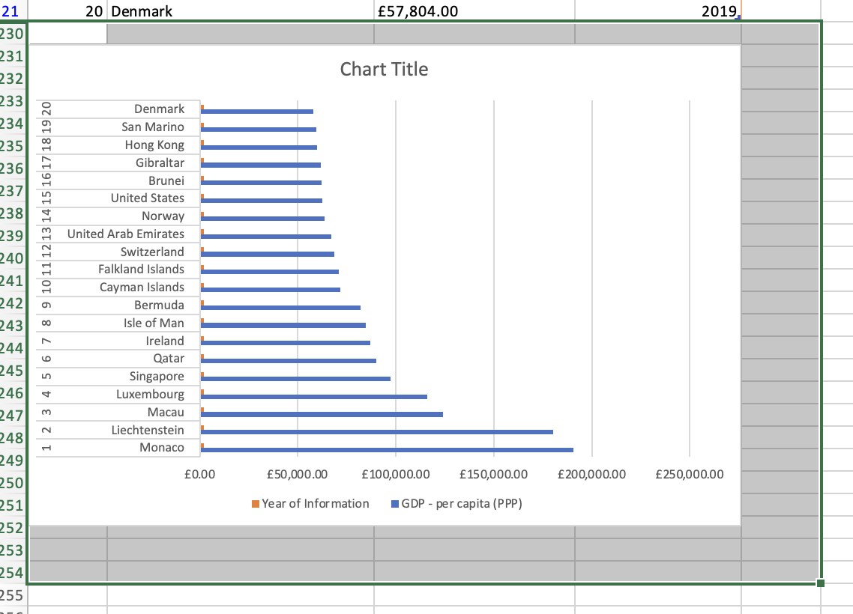
Colour the background by finding the add fill colour icon Highlight the back of the chart, by selecting and drag down to the limit around the chart area, then from the “Home” tab, click on “fill colour” to choose the one of your choice

Slide 15
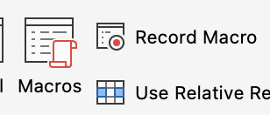

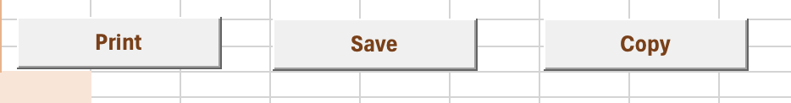
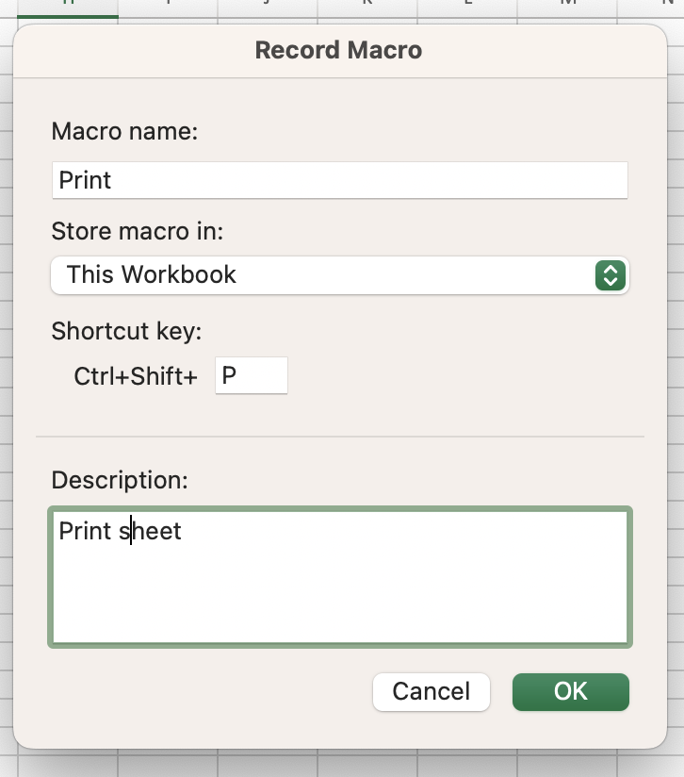
Create 3 macro buttons, Print the sheet, Save the file, Copy the sheet Begin by creating a button from the developer tab, choose cell to insert button, press the record macro button and select which cell you want to “Print, Save or Copy”, once recording is done, press stop, right click the button and press assign macro

Slide 16
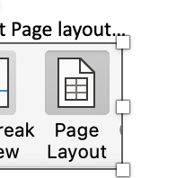
Adding Header and Footer Go to view, select Page layout… Once Header and Footer are added to the page, click “Normal” from the View Tab

Slide 17
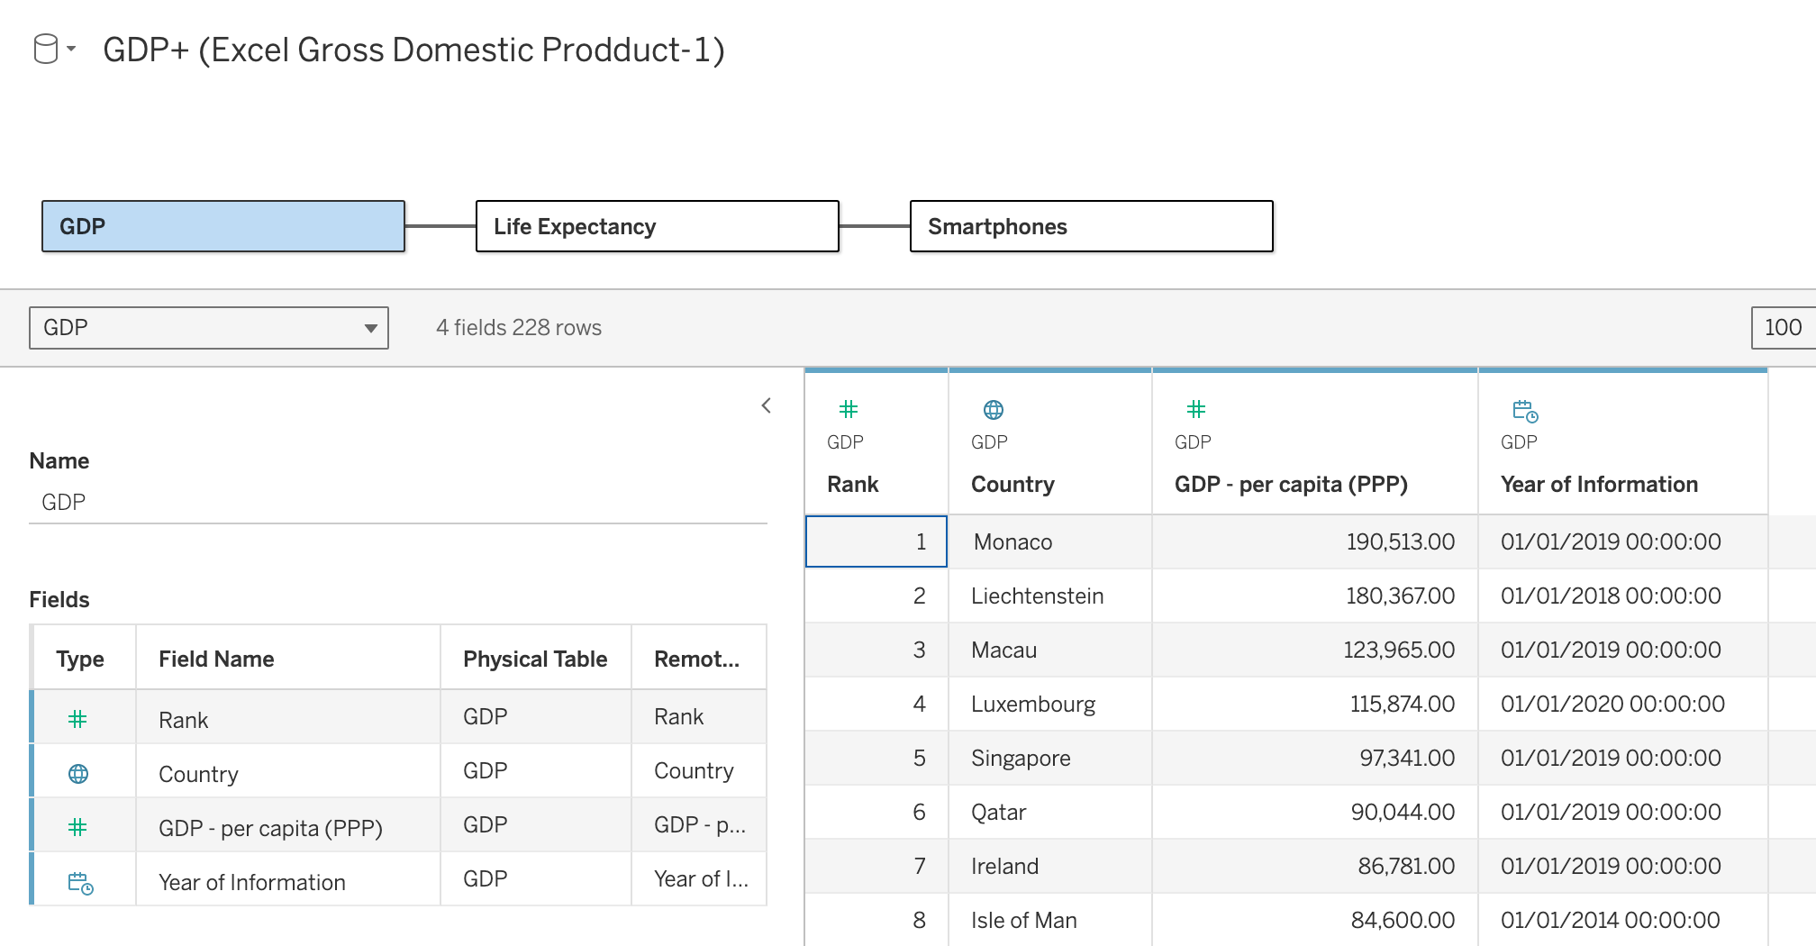
Tableau the dataset was used to explore correlations between economic wealth, healthcare outcomes, and technology access across countries

Slide 18
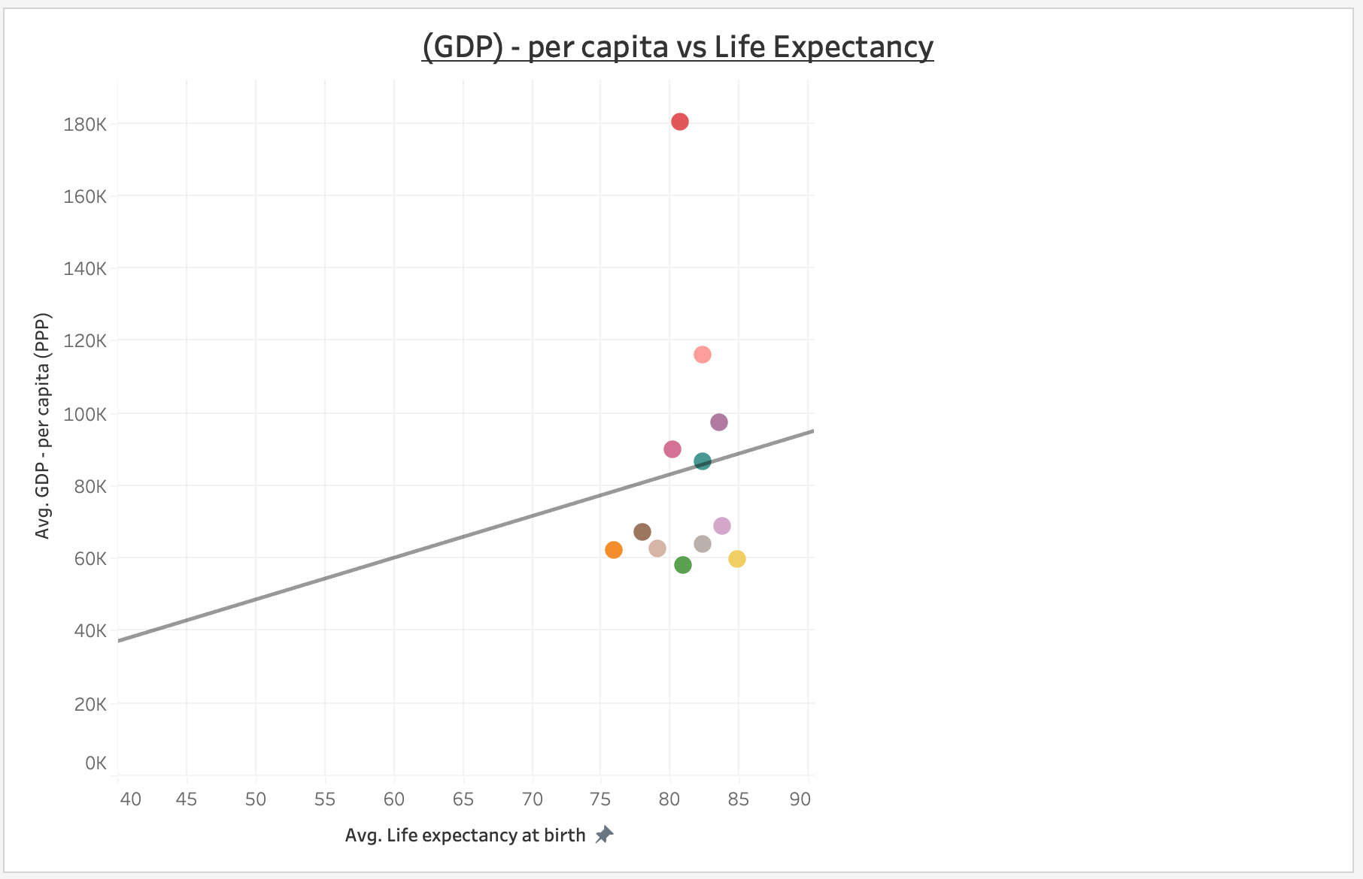
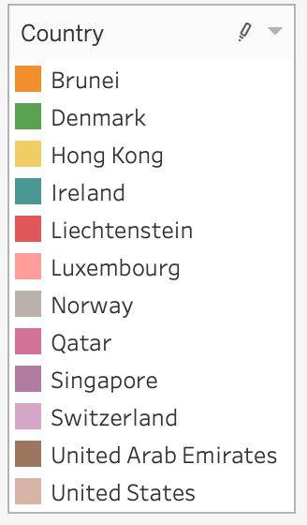
Scatter visual visualizing the relationship between GDP per capita-per person and life expectancy at birth for various country. The trend line is displayed, indicating the correlation between GDP and life expectancy

Slide 19
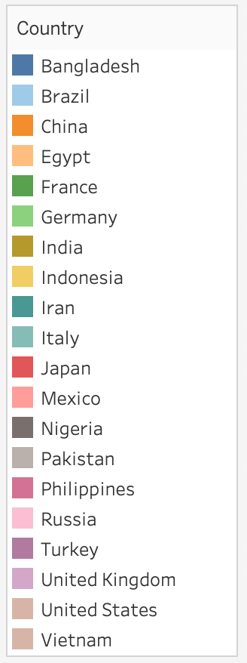
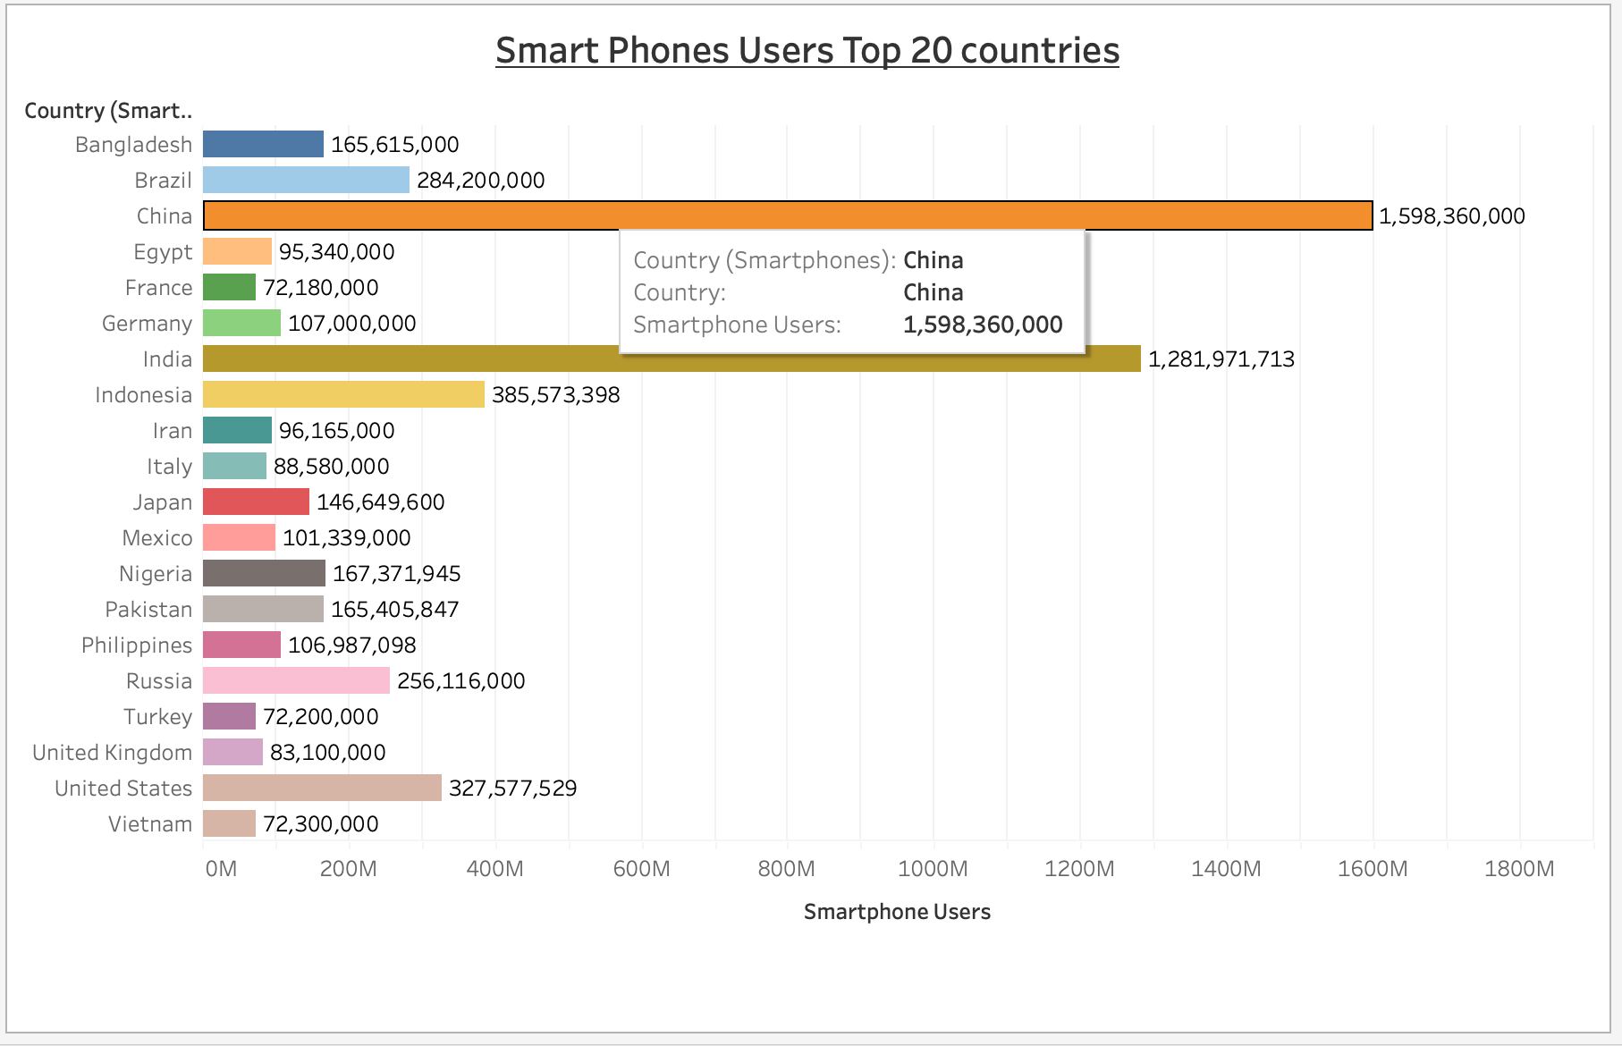
Bar visual

Slide 20
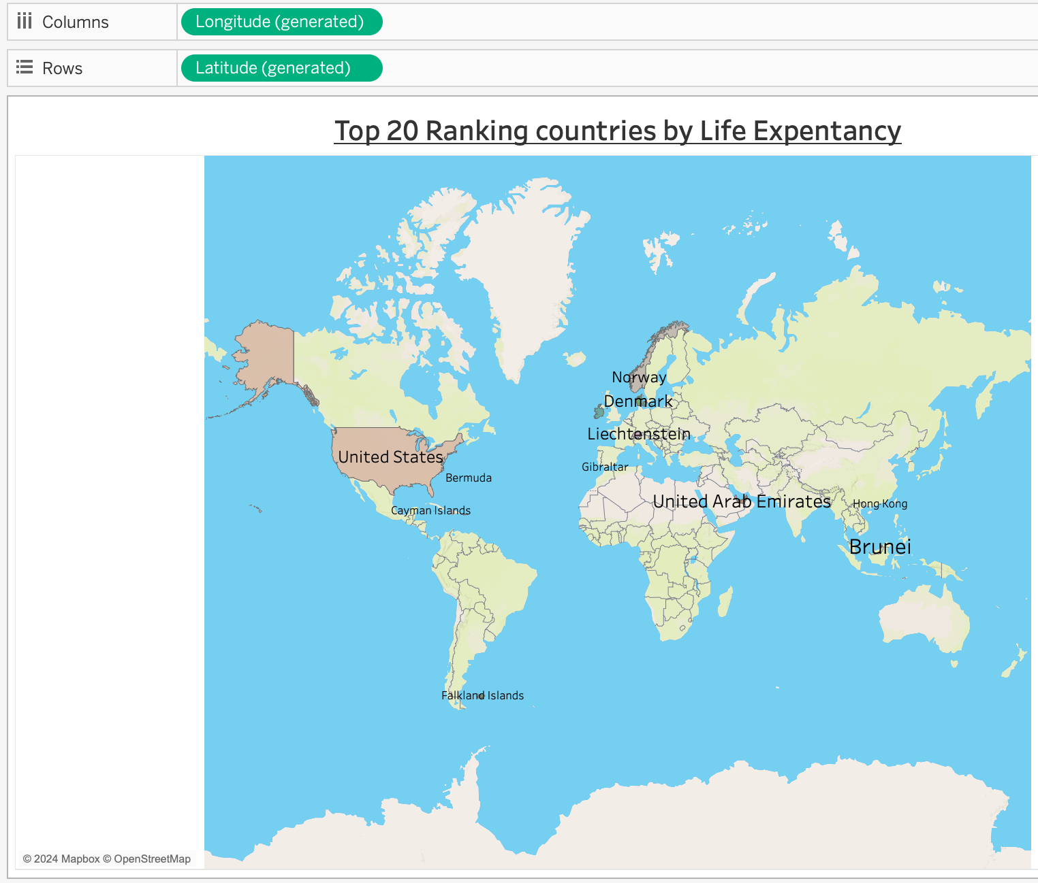
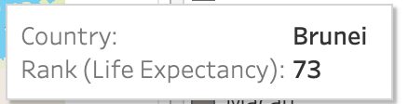
Map visual

Slide 21
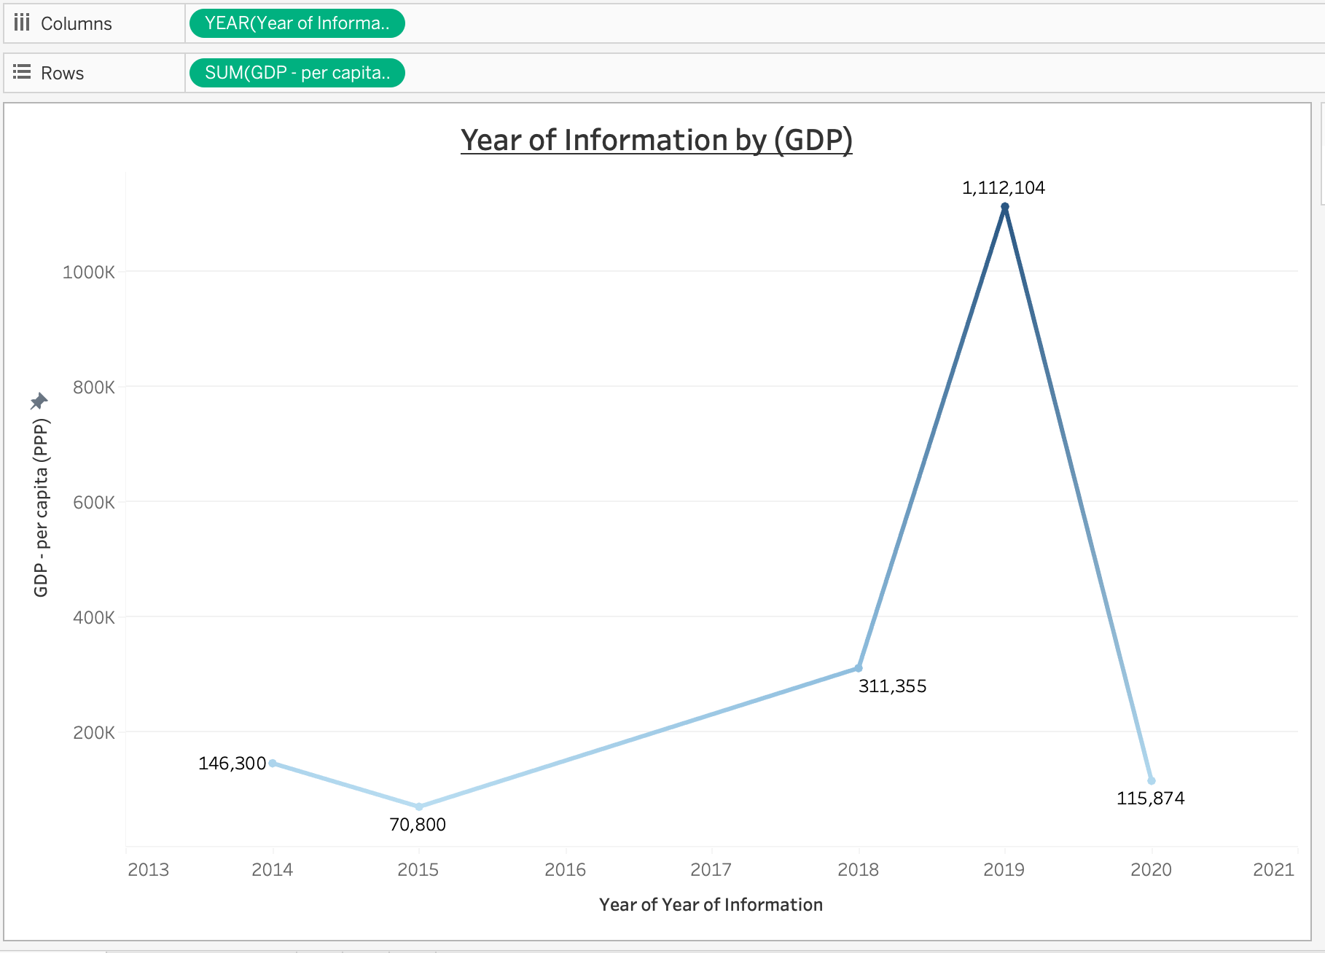
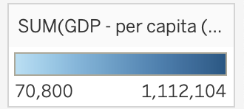
Line visual

Slide 22
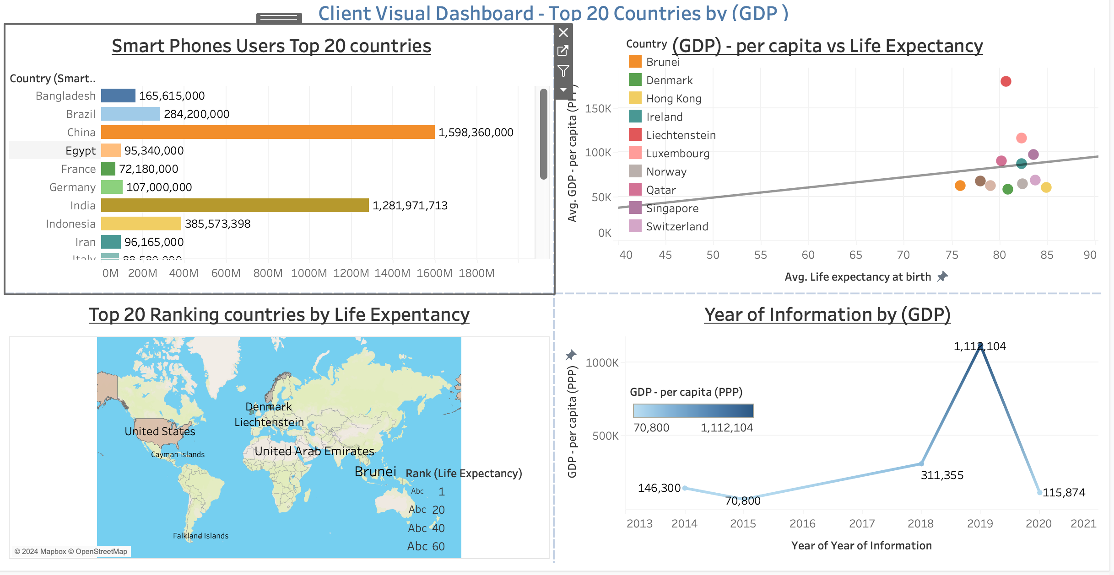

Slide 23
Conclusion
In this project, I utilised Excel and Tableau to analyse, visualise and interpret key datasets relevant to global economic and social indicators. Although, I am an Excel beginner level, I understand that by leveraging its powerful data processing capabilities, I was able to clean and organise large datasets.
Subsequently, as a first time Tableau user, Tableau was used to create dynamic and interactive visualizations, allowing for deeper insights and more intuitive understanding of the trends.
The Bar Chart visualisation highlighted the vast differences in smartphone penetration across the 20 countries. Indicates levels of technological adoption, that correlate with both population size and economic development.
The scatter plot showcases the relationship between GPD per capita and life expectancy.
As expected, countries with higher GPD per capita generally tend to have higher life expectancy.
The Map visualization, allowed for a geographical perspective on life expectancy, clearly showing regional disparities that are important for policymakers to consider global health initiatives.
Lastly, the line chart, provides a historical overview of GDP per capita trends, showing economic fluctuations over recent years. The spike observed in certain years, prompts further investigation into economic events that may have caused changes

Slide 24
Final considerations
The combination of Excel and tableau in this assignment, demonstrates the power of data visualisation in making complex datasets more accessible and easier to understand.
For future work, integrating more real time-data, could provide even more comprehensive insights. Additionally, refining the visualizations based on user feedback, could further enhance the dashboard’s usability and impact
Overall, this project underscores the importance of data-driven decision making and the role that tools like Excel and Tableau can play, in presenting those decisions.

